Slide 1
Chapter 2
Logic gates

Slide 2
A
X
The Inverter
The inverter performs the Boolean NOT operation. When the input is LOW, the output is HIGH; when the input is HIGH, the output is LOW.
LOW (0) HIGH (1)
HIGH (1) LOW(0)
The NOT operation (complement) is shown with an overbar. Thus, the Boolean expression for an inverter is X = A.

Slide 3
A
X
The Inverter
Example waveforms:
A
X
A group of inverters can be used to form the 1’s complement of a binary number:
Binary number
1 0 0 0 1 1 0 1
0 1 1 1 0 0 1 0
1’s complement

Slide 4
A
A
The AND Gate
X
X
B
B
The AND gate produces a HIGH output when all inputs are HIGH; otherwise, the output is LOW. For a 2-input gate, the truth table is
0 0
0 1
1 0
1 1
0
0
0
1
The AND operation is usually shown with a dot between the variables but it may be implied (no dot). Thus, the AND operation is written as X = A .B or X = AB.

Slide 5
A
A
The AND Gate
X
X
B
B
Example waveforms:
A
B
X
The AND operation is used in computer programming as a selective mask. If you want to retain certain bits of a binary number but reset the other bits to 0, you could set a mask with 1’s in the position of the retained bits.
Example
If the binary number 10100011 is ANDed with the mask 00001111, what is the result?
00000011

Slide 6
The OR Gate
A
X
A
X
B
B
The OR gate produces a HIGH output if any input is HIGH; if all inputs are LOW, the output is LOW. For a 2-input gate, the truth table is
0 0
0 1
1 0
1 1
0
1
1
1
The OR operation is shown with a plus sign (+) between the variables. Thus, the OR operation is written as X = A + B.

Slide 7
The OR Gate
A
X
A
X
B
B
Example waveforms:
A
B
X
The OR operation can be used in computer programming to set certain bits of a binary number to 1.
Example
ASCII letters have a 1 in the bit 5 position for lower case letters and a 0 in this position for capitals. (Bit positions are numbered from right to left starting with 0.) What will be the result if you OR an ASCII letter with the 8-bit mask 00100000?
Solution
The resulting letter will be lower case.

Slide 8
A
X
A
X
The NAND Gate
B
B
The NAND gate produces a LOW output when all inputs are HIGH; otherwise, the output is HIGH. For a 2-input gate, the truth table is
0 0
0 1
1 0
1 1
1
1
1
0
The NAND operation is shown with a dot between the variables and an overbar covering them. Thus, the NAND operation is written as X = A .B (Alternatively, X = AB.)

Slide 9
A
X
A
X
The NAND Gate
B
B
Example waveforms:
A
B
X
The NAND gate is particularly useful because it is a “universal” gate – all other basic gates can be constructed from NAND gates.
Question
How would you connect a 2-input NAND gate to form a basic inverter?

Slide 10
The NOR Gate
A
X
A
X
B
B
The NOR gate produces a LOW output if any input is HIGH; if all inputs are HIGH, the output is LOW. For a 2-input gate, the truth table is
0 0
0 1
1 0
1 1
1
0
0
0
The NOR operation is shown with a plus sign (+) between the variables and an overbar covering them. Thus, the NOR operation is written as X = A + B.

Slide 11
The NOR Gate
A
X
A
X
B
B
Example waveforms:
A
B
X
The NOR operation will produce a LOW if any input is HIGH.
Example
When is the LED is ON for the circuit shown?
Solution
The LED will be on when any of the four inputs are HIGH.

Slide 12
The XOR Gate
A
X
A
X
B
B
The XOR gate produces a HIGH output only when both inputs are at opposite logic levels. The truth table is
0 0
0 1
1 0
1 1
0
1
1
0
The XOR operation is written as X = AB + AB. Alternatively, it can be written with a circled plus sign between the variables as X = A + B.

Slide 13
The XOR Gate
A
X
A
X
B
B
Example waveforms:
A
B
X
Notice that the XOR gate will produce a HIGH only when exactly one input is HIGH.
Question
If the A and B waveforms are both inverted for the above waveforms, how is the output affected?
There is no change in the output.

Slide 14
The XNOR Gate
A
X
A
X
B
B
The XNOR gate produces a HIGH output only when both inputs are at the same logic level. The truth table is
0 0
0 1
1 0
1 1
1
0
0
1
The XNOR operation shown as X = AB + AB. Alternatively, the XNOR operation can be shown with a circled dot between the variables. Thus, it can be shown as X = A . B.

Slide 15
The XNOR Gate
A
X
A
X
B
B
Example waveforms:
A
B
X
Notice that the XNOR gate will produce a HIGH when both inputs are the same. This makes it useful for comparison functions.
Question
If the A waveform is inverted but B remains the same, how is the output affected?
The output will be inverted.

Slide 16
Fixed Function Logic
Two major fixed function logic families are TTL and CMOS. A third technology is BiCMOS, which combines the first two. Packaging for fixed function logic is shown.
DIP package SOIC package

Slide 17
Fixed Function Logic
Some common gate configurations are shown.

Slide 18
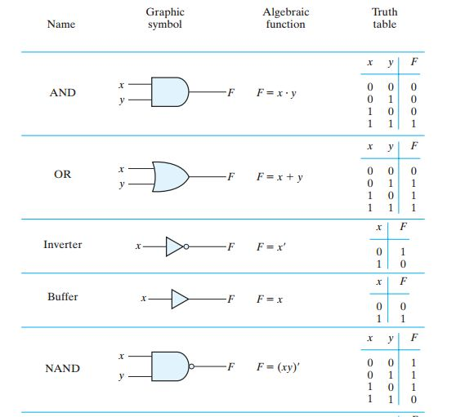

Slide 19
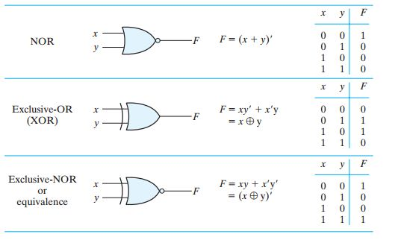

Slide 20
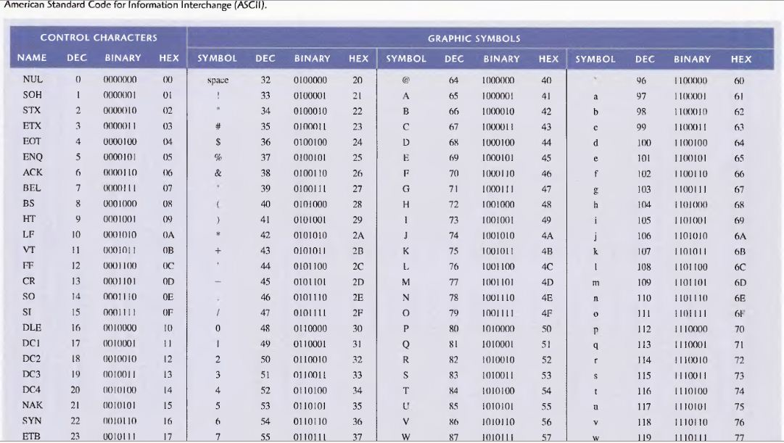
Back

Slide 21
Boolean algebra and Logic Simplification

Slide 22
Boolean Addition
In Boolean algebra, a variable is a symbol used to represent an action, a condition, or data. A single variable can only have a value of 1 or 0.
The complement represents the inverse of a variable and is indicated with an overbar. Thus, the complement of A is A.
A literal is a variable or its complement.
Addition is equivalent to the OR operation. The sum term is 1 if one or more of the literals are 1. The sum term is zero only if each literal is 0.
Example
Determine the values of A, B, and C that make the sum term of the expression A + B + C = 0?
Solution
Each literal must = 0; therefore A = 1, B = 0 and C = 1.

Slide 23
Boolean Multiplication
In Boolean algebra, multiplication is equivalent to the AND operation. The product of literals forms a product term. The product term will be 1 only if all of the literals are 1.
Example
What are the values of A, B and C if the product term of A.B.C = 1?
Solution
Each literal must = 1; therefore A = 1, B = 0 and C = 0.

Slide 24
Commutative Laws
The commutative laws are applied to addition and multiplication. For addition, the commutative law states
In terms of the result, the order in which variables are ORed makes no difference.
A + B = B + A
For multiplication, the commutative law states
In terms of the result, the order in which variables are ANDed makes no difference.
AB = BA

Slide 25
Associative Laws
The associative laws are also applied to addition and multiplication. For addition, the associative law states
When ORing more than two variables, the result is the same regardless of the grouping of the variables.
A + (B +C) = (A + B) + C
For multiplication, the associative law states
When ANDing more than two variables, the result is the same regardless of the grouping of the variables.
A(BC) = (AB)C

Slide 26
Distributive Law
The distributive law is the factoring law. A common variable can be factored from an expression just as in ordinary algebra. That is
A(B+ C)= AB + AC and A+(B.C) = (A+B)(A+ C)
The distributive law can be illustrated with equivalent circuits:
A(B+ C)
AB + AC

Slide 27
Rules of Boolean Algebra
1. A + 0 = A
7. A . A = A
2. A + 1 = 1
8. A . A = 0
=
3. A . 0 = 0
9. A = A
4. A . 1 = A
10. A + AB = A
5. A + A = A
11. A + AB = A + B
6. A + A = 1
12. (A + B)(A + C) = A + BC

Slide 28
Rules of Boolean Algebra
Rules of Boolean algebra can be illustrated with Venn diagrams. The variable A is shown as an area.
The rule A + AB = A can be illustrated easily with a diagram. Add an overlapping area to represent the variable B.
The overlap region between A and B represents AB.
=
The diagram visually shows that A + AB = A. Other rules can be illustrated with the diagrams as well.

Slide 29
Rules of Boolean Algebra
Illustrate the rule with a Venn diagram.
Example
A + AB = A + B
Solution
This time, A is represented by the blue area and B again by the red circle.
The intersection represents AB.
Notice that A + AB = A + B
A

Slide 30
Rules of Boolean Algebra
Rule 12, which states that (A + B)(A + C) = A + BC, can be proven by applying earlier rules as follows:
(A + B)(A + C) = AA + AC + AB + BC
= A + AC + AB + BC
= A(1 + C + B) + BC
= A . 1 + BC
= A + BC
This can also be shown with a Venn diagram, as given on the following slide…

Slide 31
Three areas represent the variables A, B, and C.
The area representing A + B is shown in yellow.
The area representing A + C is shown in red.
The overlap of red and yellow is shown in orange.
The overlapping area between B and C represents BC.
ORing with A gives the same area as before.
=
(A + B)(A + C)
A + BC

Slide 32
DeMorgan’s Theorem
DeMorgan’s 1st Theorem
The complement of a product of variables is equal to the sum of the complemented variables.
AB = A + B
Applying DeMorgan’s first theorem to gates:

Slide 33
DeMorgan’s Theorem
DeMorgan’s 2nd Theorem
The complement of a sum of variables is equal to the product of the complemented variables.
A + B = A . B
Applying DeMorgan’s second theorem to gates:

Slide 34
DeMorgan’s Theorem
Example
Apply DeMorgan’s theorem to remove the overbar covering both terms from the
expression X = C + D.
Solution
To apply DeMorgan’s theorem to the expression, you can break the overbar covering both terms and change the sign between the terms. This results in
X = C . D. Deleting the double bar gives X = C . D.
=

Slide 35
Boolean Analysis of Logic Circuits
Combinational logic circuits can be analyzed by writing the expression for each gate and combining the expressions according to the rules for Boolean algebra.
Example
Apply Boolean algebra to derive the expression for X.
Solution
Write the expression for each gate:
(A + B )
C (A + B )
= C (A + B )+ D
X
Applying DeMorgan’s theorem and the distribution law:
X = C (A B) + D = A B C + D

Slide 36
SOP and POS forms
Boolean expressions can be written in the sum-of-products form (SOP) or in the product-of-sums form (POS). These forms can simplify the implementation of combinational logic, particularly with PLDs. In both forms, an overbar cannot extend over more than one variable.
An expression is in SOP form when two or more product terms are summed as in the following examples:
A B C + A B A B C + C D C D + E
An expression is in POS form when two or more sum terms are multiplied as in the following examples:
(A + B)(A + C) (A + B + C)(B + D) (A + B)C

Slide 37
SOP Standard form
In SOP standard form, every variable in the domain must appear in each term. This form is useful for constructing truth tables or for implementing logic in PLDs.
You can expand a nonstandard term to standard form by multiplying the term by a term consisting of the sum of the missing variable and its complement.
Example
Convert X = A B + A B C to standard form.
Solution
The first term does not include the variable C. Therefore, multiply it by the (C + C), which is = 1:
X = A B (C + C) + A B C
= A B C + A B C + A B C

Slide 38
POS Standard form
In POS standard form, every variable in the domain must appear in each sum term of the expression.
You can expand a nonstandard POS expression to standard form by adding the product of the missing variable and its complement and applying rule 12, which states that (A + B)(A + C) = A + BC.
Example
Convert X = (A + B)(A + B + C) to standard form.
Solution
The first sum term does not include the variable C. Therefore, add C C and expand the result by rule 12.
X = (A + B + C C)(A + B + C)
= (A +B + C )(A + B + C)(A + B + C)

Slide 39
Karnaugh maps
The Karnaugh map (K-map) is a tool for simplifying combinational logic with 3 or 4 variables. For 3 variables, 8 cells are required (2³).
The map shown is for three variables labeled A, B, and C. Each cell represents one possible product term.
Each cell differs from an adjacent cell by only one variable.

Slide 40
Karnaugh maps
Cells are usually labeled using 0’s and 1’s to represent the variable and its complement.
The numbers are entered in gray code, to force adjacent cells to be different by only one variable.
Gray code
Ones are read as the true variable and zeros are read as the complemented variable.

Slide 41
Karnaugh maps
Alternatively, cells can be labeled with the variable letters. This makes it simple to read, but it takes more time preparing the map.
C C
Example
Read the terms for the yellow cells.
AB
AB
AB
AB
Solution
The cells are ABC and ABC.

Slide 42
Karnaugh maps
K-maps can simplify combinational logic by grouping cells and eliminating variables that change.
Example
Group the 1’s on the map and read the minimum logic.
Solution
1. Group the 1’s into two overlapping groups as indicated.
Read each group by eliminating any variable that changes across a boundary.
B changes across this boundary
The vertical group is read AC.
C changes across this boundary
The horizontal group is read AB.
X = AC +AB

Slide 43
Karnaugh maps
A 4-variable map has an adjacent cell on each of its four boundaries as shown.
Each cell is different only by one variable from an adjacent cell.
Grouping follows the rules given in the next slide.
The following slide shows an example of reading a four variable map using binary numbers for the variables…

Slide 44
Determining the Minimum SOP Expression from the Map When all the 1’s representing the standard product terms in an expression are properly mapped and grouped, the process of determining the resulting minimum SOP expression begins.
The following rules are applied to find the minimum product terms and the minimum SOP expression:
1. Group the cells that have 1’s. Each group of cells containing 1’s creates one product term composed of all variables that occur in only one form (either uncomplemented or complemented) within the group. Variables that occur both uncomplemented and complemented within the group are eliminated. These are called contradictory variables.

Slide 45
2. Determine the minimum product term for each group.
a. For a 3-variable map:
(1) A l-cell group yields a 3-variable product term
(2) A 2-cell group yields a 2-variable product term
(3) A 4-cell group yields a I-variable term
(4) An 8-cell group yields a value of I for the expression
b. For a 4-variable map:
(1) A I-cell group yields a 4-variable product term
(2) A 2-cell group yields a 3-variable product term
(3) A 4-cell group yields a 2-variable product term
(4) An 8-cell group yields a I-variable term
(5) A 16-cell group yields a value of I for the expression
3. When all the minimum product terms are derived from the Karnaugh map, they are summed to form the minimum SOP expression.

Slide 46
Karnaugh maps
Example
Group the 1’s on the map and read the minimum logic.
C changes across outer boundary
Solution
1. Group the 1’s into two separate groups as indicated.
Read each group by eliminating any variable that changes across a boundary.
B changes
B changes
The upper (yellow) group is read as AD.
The lower (green) group is read as AD.
C changes
X
X = AD +AD

Slide 47
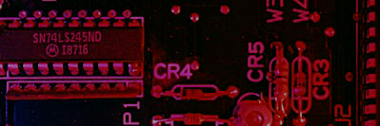
Selected Key Terms
Inverter
Truth table
Timing diagram
Boolean algebra
AND gate
A logic circuit that inverts or complements its inputs.
A table showing the inputs and corresponding output(s) of a logic circuit.
A diagram of waveforms showing the proper time relationship of all of the waveforms.
The mathematics of logic circuits.
A logic gate that produces a HIGH output only when all of its inputs are HIGH.

Slide 48
Selected Key Terms
OR gate
NAND gate
NOR gate
Exclusive-OR gate
Exclusive-NOR gate
A logic gate that produces a HIGH output when one or more inputs are HIGH.
A logic gate that produces a LOW output only when all of its inputs are HIGH.
A logic gate that produces a LOW output when one or more inputs are HIGH.
A logic gate that produces a HIGH output only when its two inputs are at opposite levels.
A logic gate that produces a LOW output only when its two inputs are at opposite levels.

Slide 49
Selected Key Terms
Variable
Complement
Sum term
Product term
A symbol used to represent a logical quantity that can have a value of 1 or 0, usually designated by an italic letter.
The inverse or opposite of a number. In Boolean algebra, the inverse function, expressed with a bar over the variable.
The Boolean sum of two or more literals equivalent to an OR operation.
The Boolean product of two or more literals equivalent to an AND operation.

Slide 50
Selected Key Terms
Sum-of-products (SOP)
Product of sums (POS)
Karnaugh map
A form of Boolean expression that is basically the ORing of ANDed terms.
A form of Boolean expression that is basically the ANDing of ORed terms.
An arrangement of cells representing combinations of literals in a Boolean expression and used for systematic simplification of the expression.
------------------End--------------

